Slide 1
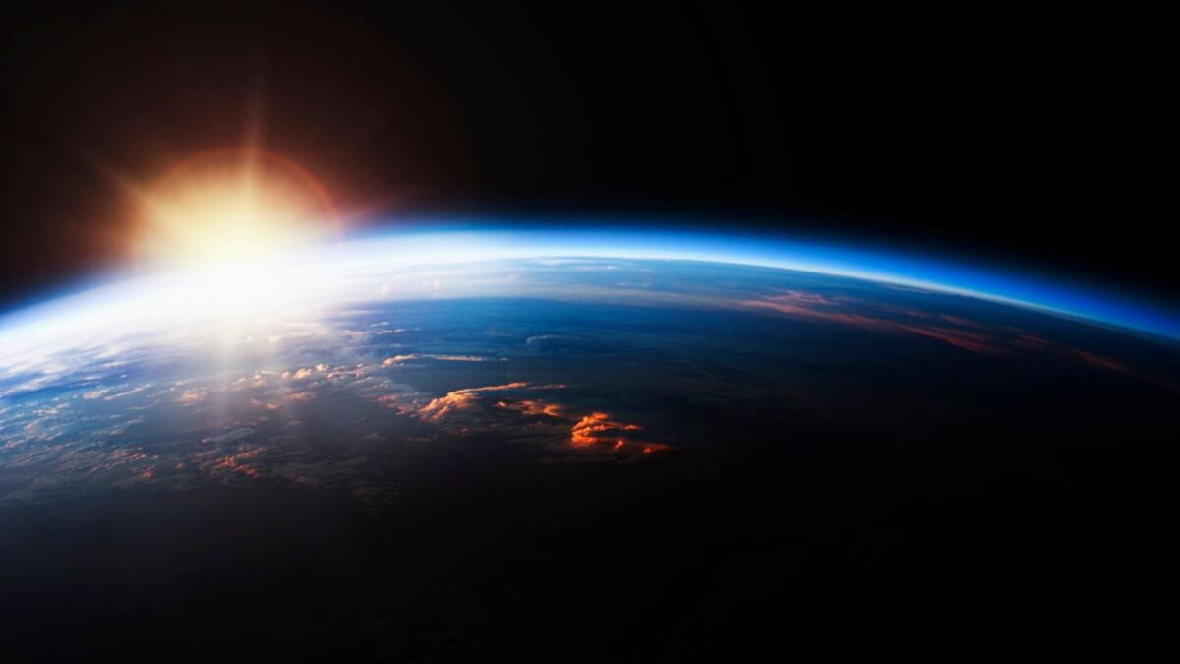
SolaNet
Unlock undiscovered solar energy potential with the help of AI
Carmen Berndt, Christoph Dobra, Max Herbst & Haokun Zheng

Slide 2
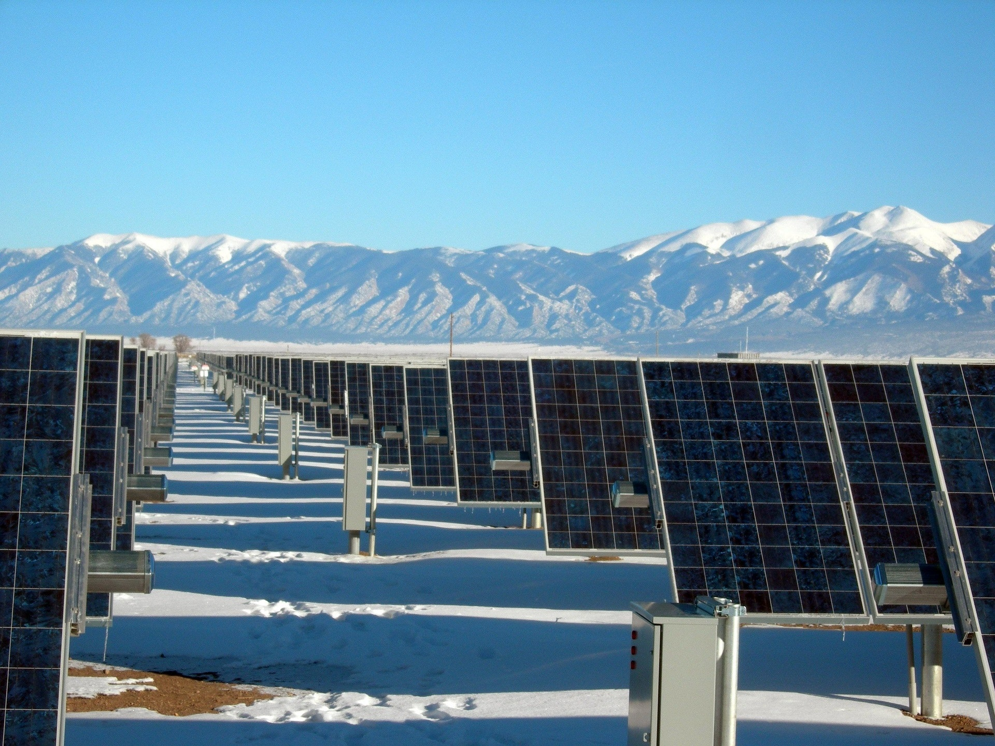
MOTIVATION

Slide 3
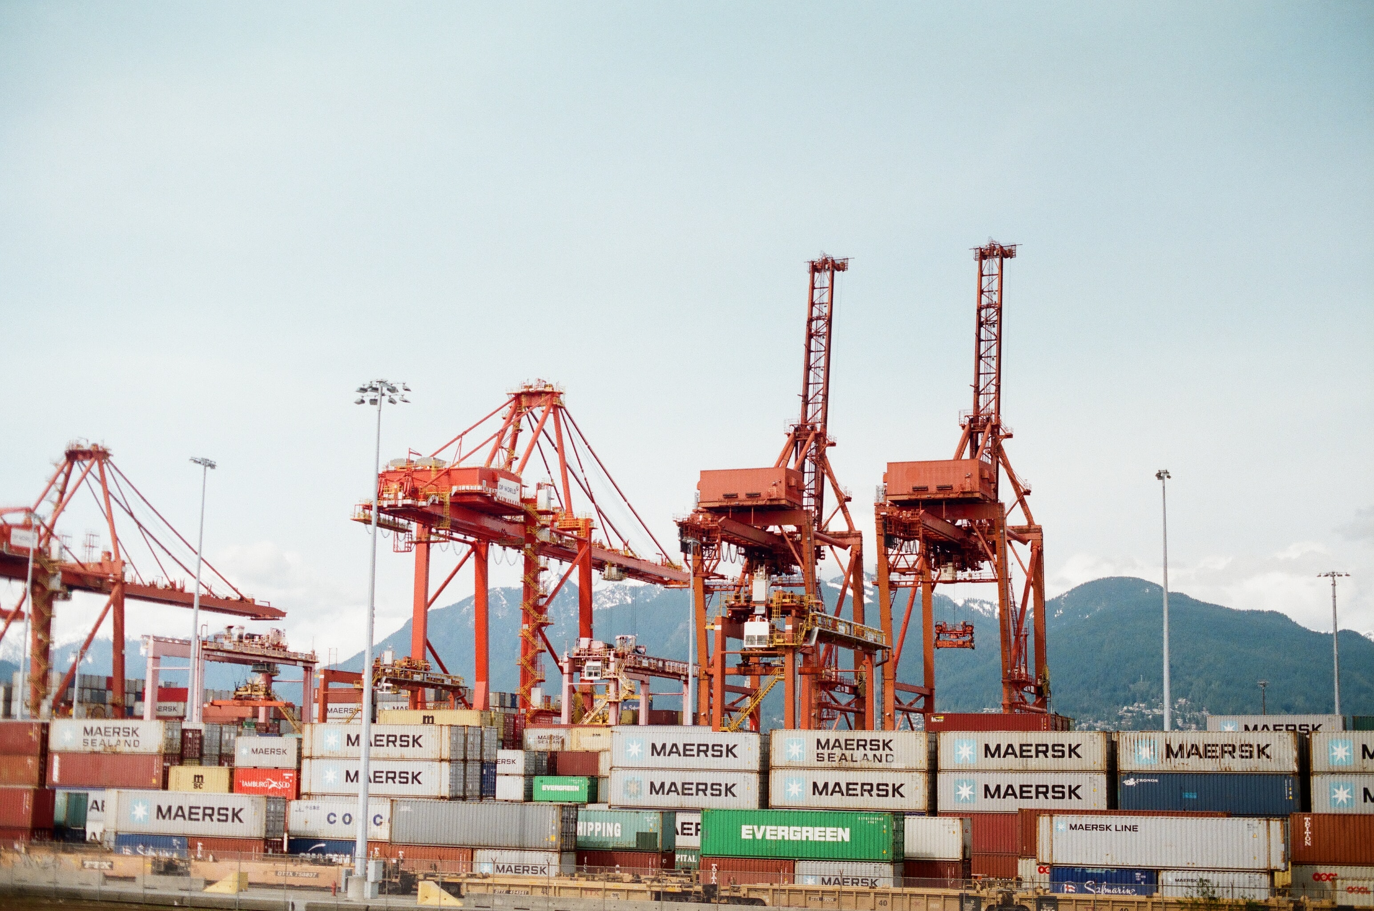
Motivation
Solar energy for more sustainable energy
Hard to use calculators
Due to the difficulty of existing solar panel system estimations, many suitable areas
The energy sector is one of the largest emitters of CO2 emissions. Green energy solutions like solar panels play a vital role in reducing emissions.
Many unused areas
U.S. Commercial Rooftops Hold 145 Gigawatts of Untapped Solar Potential

Slide 4
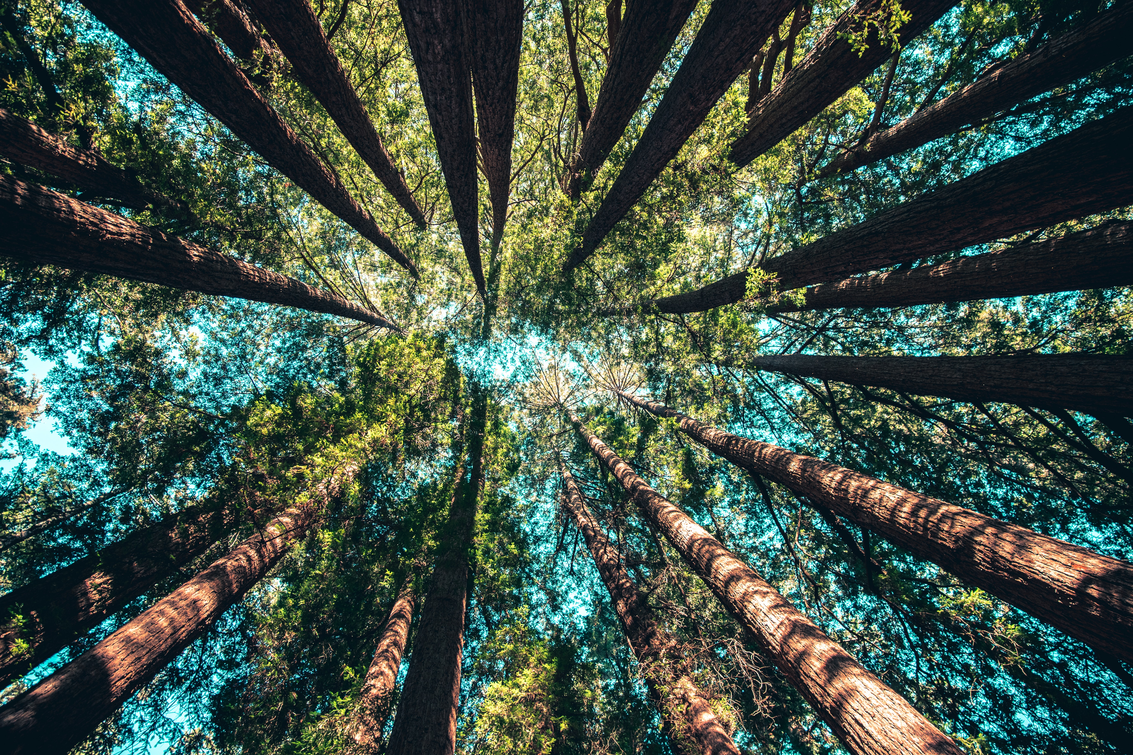
A solution powered by AI
By combining broadly available satellite images and semantic segmentation computer vision, we built an app that allows virtually anyone in the world to consider a solar energy solution.

Slide 5
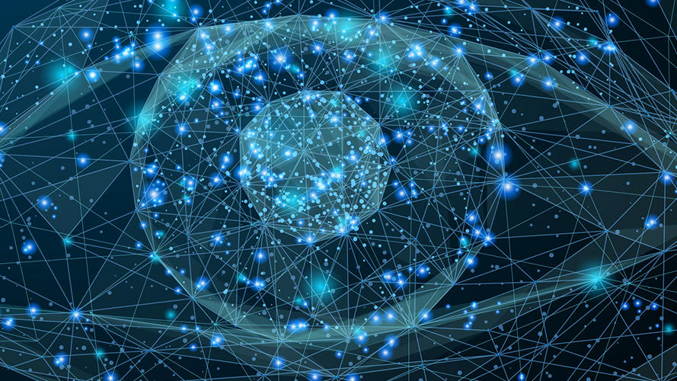
High level processing overview

Slide 6
Processing
User enters address where a potential solar panel system should be evaluated
Respective satellite imagery is pulled from MapBox
Our trained model isolates the roofs and calculates the surface area

Slide 7
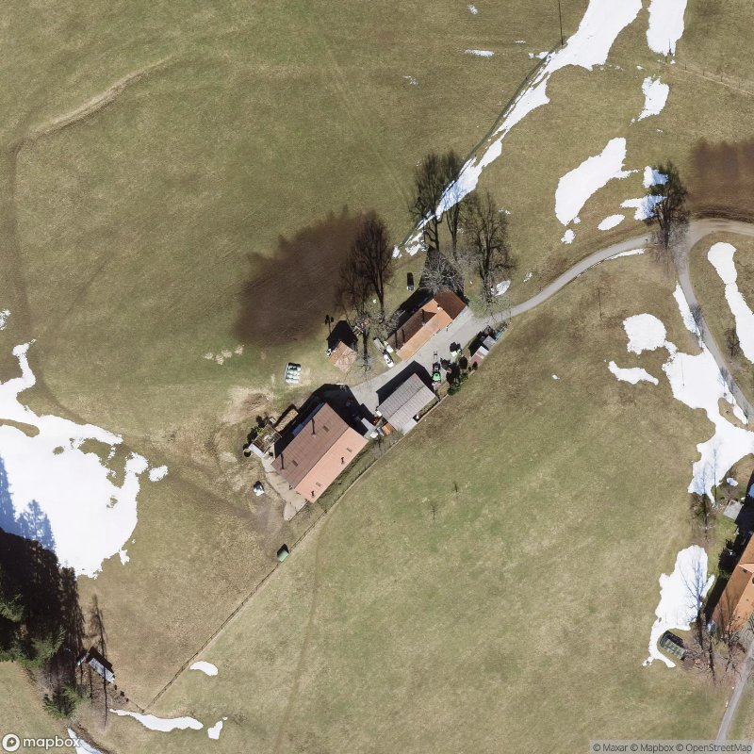
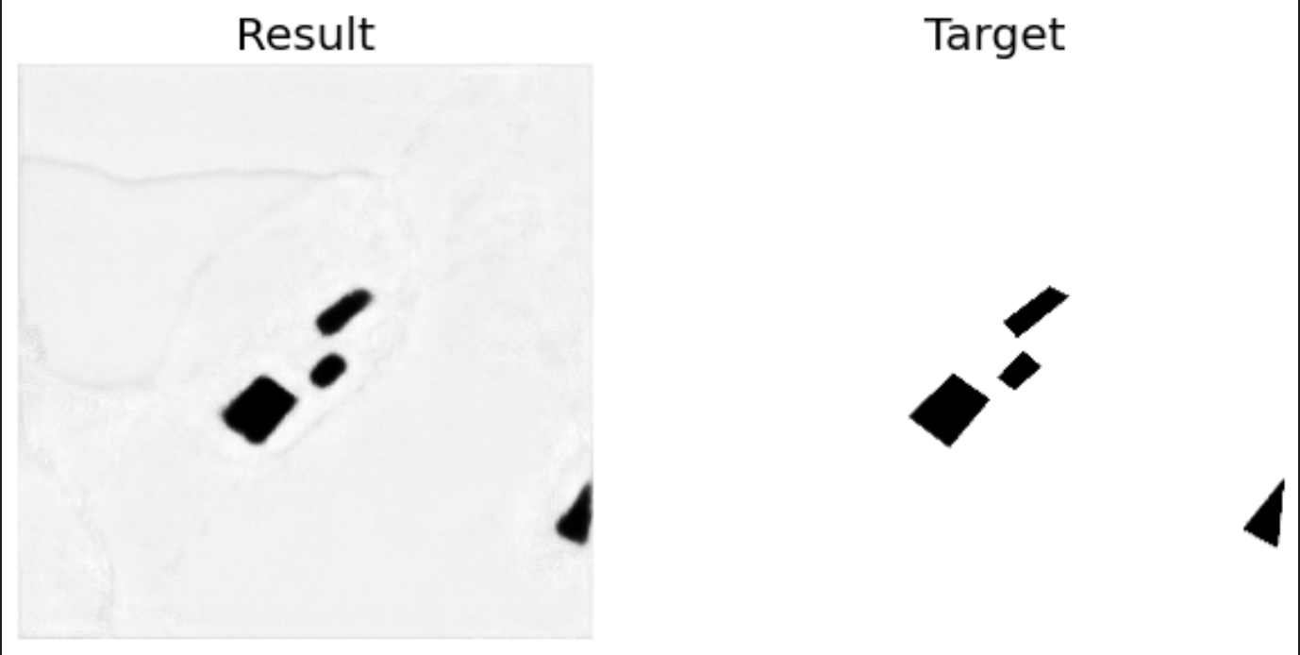
Results of our model

Slide 8
Processing
Further analysis is executed and displayed based on available surface area

Slide 9
Live Demo

Slide 10
SolaNet
Thank you for your attention, we are looking forward to your questions!
Built by Carmen Berndt, Christoph Dobra, Max Herbst & Haokun Zheng

